Slide 1
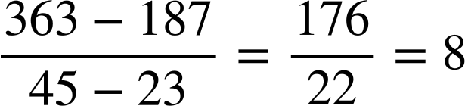
Problem solving with sequences
Task A: Generalising from non-sequential terms
Term-to-
term rule
1) Fill in the missing terms in these arithmetic sequences.
Term number (n) | 1 | 2 | 3 | 4 | 5 | 6
a) | −26 | −17 | −8 | 1 | 10 | 19
b) | −2 | 1 | 4 | 7 | 10 | 13
c) | −3.5 | 1 | 5.5 | 10 | 14.5 | 19
d) | 10 | 7.75 | 5.5 | 3.25 | 1 | −1.25
+9
+3
+4.5
−2.25
2) What happens when you try to find the missing terms in this sequence? What does that tell you about this sequence?
2, 12, 22, 32, 65, 98, …
Between 2 and 32, the common difference will be 10 (2, 12, 22, 32) but between 32 and 98 the common difference will be 33 (32, 65, 98).
We won’t get a common, constant difference between terms so this must not be an arithmetic sequence.
3) The 23rd term of an arithmetic sequence is 187 and the 45th term is 363.
a) Find the 100th term.
When n = 100 the term value is 8(100)+3 = 803
b) Will 3634 be a term in this sequence?
No. We have odd terms and an even common difference therefore 3634, an even number, will not be in the sequence.

Slide 2
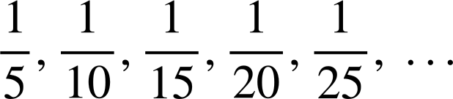

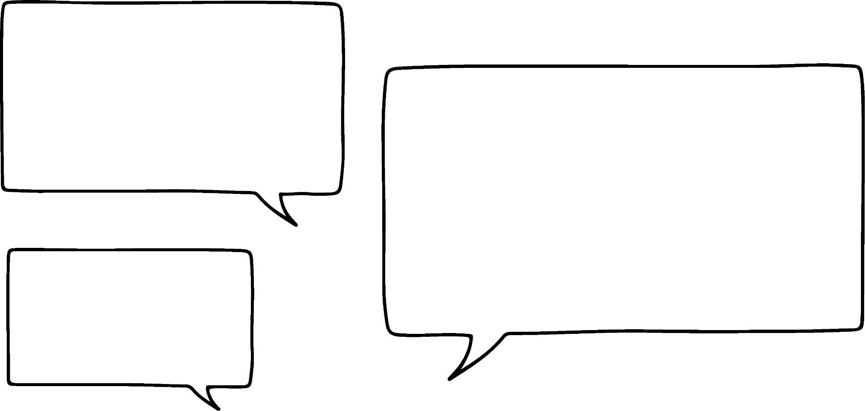


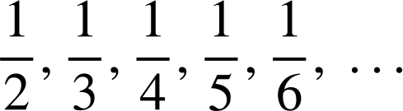
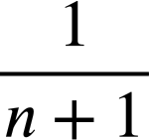
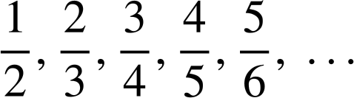
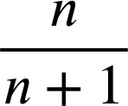
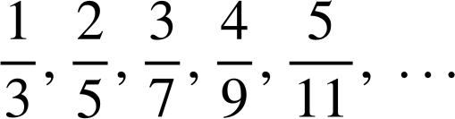
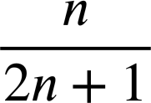
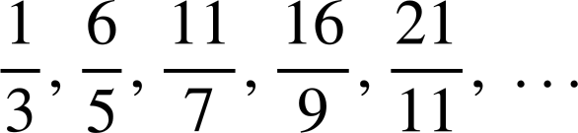
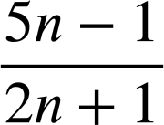
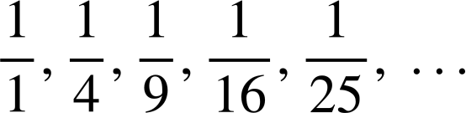

Problem solving with sequences
Task B: Fractional sequences
1) Jun and Laura are looking at a sequence.
5, 10, 15, 20, 25, …
This is an increasing sequence.
5, 10, 15, 20, 25, … That’s 5n.
This is an arithmetic sequence.
a) Justify why Jun is wrong.
The sequence is decreasing.
b) Justify why Laura is wrong.
There is not a common difference so our sequence is not arithmetic.
But Laura has spotted something useful!
2) Write an n^{th} term for these fractional sequences.
a)
b)
c)
d)
e)
Constant numerator and non-arithmetic pattern in the denominators.
Task C: Pattern spotting
1) How many squares are there on a chess board?
Square size | Frequency
8 × 8 | 1
7 × 7 | 4
6 × 6 | 9
5 × 5 | 16
4 × 4 | 25
3 × 3 | 36
2 × 2 | 49
1 × 1 | 64
Square numbers.
There are 204 squares on a chessboard.
Mathematics in Education and Industry.

